Slide 1
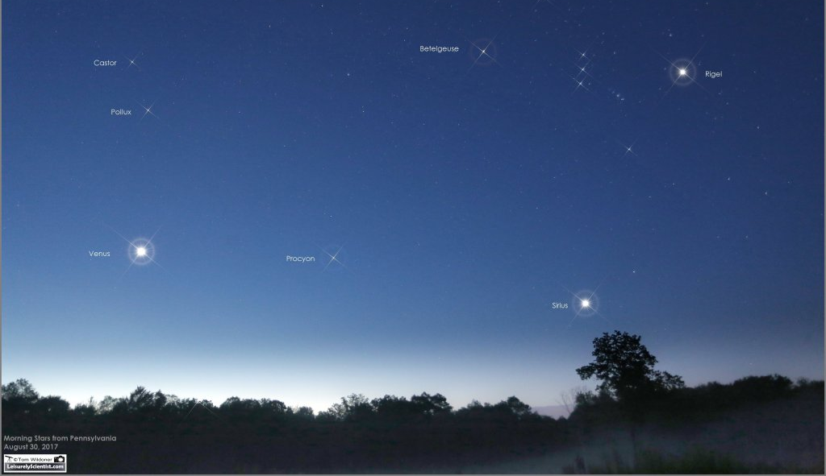
Betelgeuse
Castor
Rigel
Pollux
Procyon
Sirius

Slide 2
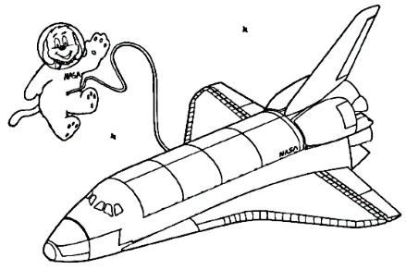
Recording Brightness From Earth
33 light years (312,200,000,000,000 km)
Recording Actual Brightness
Light Year: The distance that light can travel in one year (9,490,700,000,000 km)

Slide 3
Learning Objectives:
Students will be able to use data to support the claim that a star’s brightness as observed from Earth is a function of both distance and actual brightness.
Disciplinary Core Idea:
ESS1.A The Universe and its Stars
The Sun is a star that appears larger and brighter than other stars because it is closer. Stars range greatly in their distances from Earth.
Science and Engineering Practice:
#2 Engaging in Argument from Evidence
Engaging in argument from evidence in 3-5 builds on K-2 experience and progresses to critiquing the scientific explanations of solution proposed by peers by citing relevant evidence about the natural and designed world(s). Supporting an argument with evidence, data, or a model.
Cross Cutting Concept:
#3 Scale, Proportion, and Quantity
Natural objects exist from the very small to the immensely large.

Slide 4
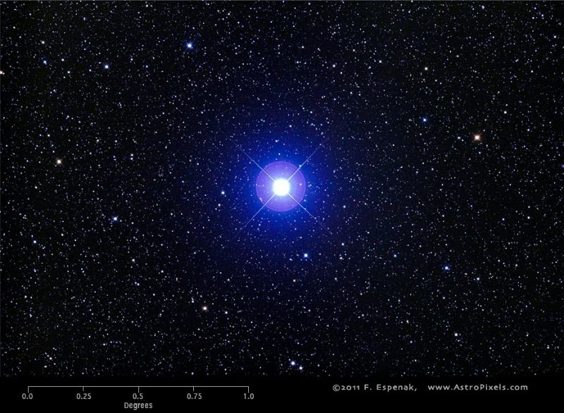
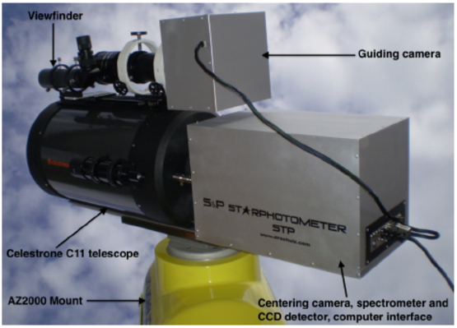
Teacher Slide Not For Students
Apparent Magnitude
(similar to brightness from Earth)
Apparent Magnitude (m): A measure of the brightness of a celestial object as seen by someone on Earth.
$\text{Apparent} \text{Magnitudes} \text{were} \text{first} \text{measured} \text{by} \text{a} \text{Greek} \text{astronomer} \text{Hipparchus} \text{in}\text{ \sim 150 }\text{BC}\text{. }\text{He} \text{set} \text{the} \text{scale} \text{for} \text{the} \text{brightest} \text{stars} \text{to} \text{be}\text{ 0 }\text{and} \text{the} \text{dimmest} \text{starts} \text{to} \text{be}\text{ 6.}$ Therefore, the brighter the star the lower the apparent magnitude.
Hipparchus though Vega was the brightest star so he set that to 0. There are brighter stars than Vega so some stars have negative apparent magnitude.
Apparent magnitude is calculated with: $m_{x}−m_{x,0}=−2.5log\left(\frac{F_{x}}{F_{x,0}}\right)$
m is the apparent magnitude
F is the flux density (energy (power of radiation) per unit area) this can be measured
m_{x,0} is the apparent magnitude of the reference object, Vega, ($m_{x,o}=0$)
F_{x,0} is the reference flux. You find this by pointing your photometer at Vega with the appropriate filter and making your measurement
Apparent Magnitude is on a logarithmic scale, like earthquakes (see table).
Apparent magnitude can be done in the ultraviolet, visible, or infrared wavelengths.
m₂-m₁ | How much brighter the brighter star will be
1 | 2.51
2 | (2.51)² = 6.31
3 | (2.51)³ = 15.85
4 | (2.51)⁴ = 39.82
5 | (2.51)² = 100
For the Activity the Brightness from Earth is Negative of the Apparent Magnitude

Slide 5
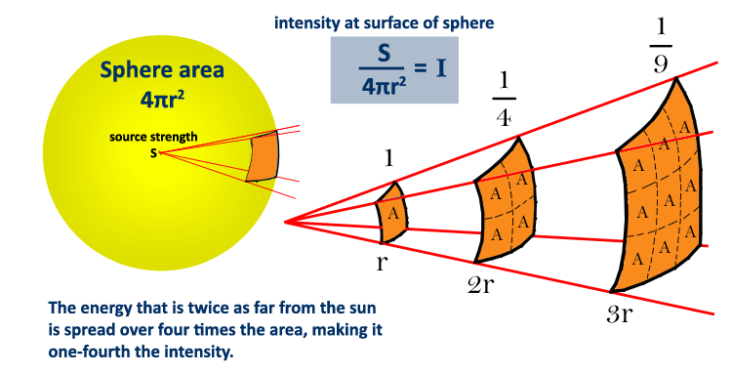
Teacher Slide Not For Students
Absolute Magnitude
(similar to actual brightness)
Absolute Magnitude (M): A measure of the brightness of a celestial object 32.6 ly (10 parsecs) from the object, the brighter an object is the lower the absolute magnitude.
If you know the distance of the object and the apparent magnitude you can calculate the absolute magnitude because we know how flux changes with distance.
$M=m−2.5log{\left(\frac{d}{10 pc}\right)}^{2}$
d is distance (must be in parsecs), m is apparent magnitude, and M is absolute magnitude
For Procyon $M=0.3−2.5log{\left(\frac{3.4 pc}{10 pc}\right)}^{2}=2.6$
For the Activity the Actual Brightness is Negative of the Absolute Magnitude

Slide 6
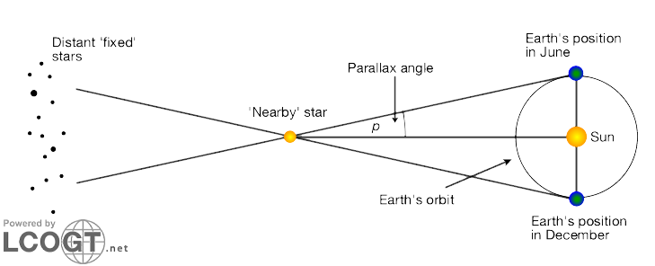
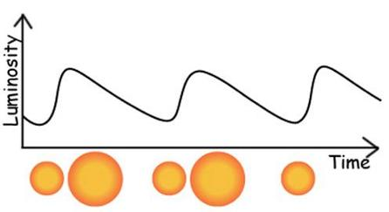
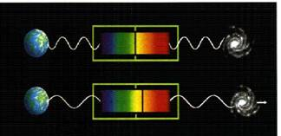
Teacher Slide Not For Students
Determining Distance to Stars
Parallax: A effect whereby the position or direction of an object appears to different when viewed from different positions
Measure how much a star seems to move at two different times in the year
The farther out the object, the harder this method is and if the object is too far (over 325 ly) this method cannot be used
Standard Candles: Objects of know brightness
Cepheid stars are a type of star that’s brightness varies in a well defined periodic manner (from a few hours to a few days) due to the stars envelope expanding and contracting
How fast they pulsate is proportional to the temperature
The temperature is proportional to the actual brightness
Brightness equations can be used to calculate distance
Doppler Affect: Increase or decreases in the frequency of sound/light waves as the source and the observer move away
The closer the object is to Earth the less red shift it will have.
The universe is expanding so all objects are moving away from each other.
If you know the wavelength the object should be. You can use the change in wavelength to calculate the distance
Notes:
Why Cepheid stars change intensity
Photons are trapped inside, heating the gas and increasing its pressure.
The high-pressure gas expands, becoming transparent.
Photons escape, the gas cools, the pressure drops.
As the pressure drops, the Cepheid is compressed by gravity.

